Slide 1
Data Analytics Internship Portfolio
ApexPlanet Software Pvt. Ltd.
Presented By: Sathvika Moturi
Duration: 60-Day Data Analytics Internship

Slide 2
Internship Objective
To develop practical skills in Data Analytics by working on real-world datasets and completing end-to-end analytics projects, from data preparation to business storytelling.
Projects Completed
✅ Task 1: Data Immersion & Wrangling
Data Cleaning
Data Transformation
Data Quality Assessment
✅ Task 2: Exploratory Data Analysis (EDA) & Business Intelligence
Data Visualization
Business Insights
KPI Analysis
✅ Task 3: Deep-Dive Analysis & Interactive Dashboarding
Dashboard Development
KPI Monitoring
Trend Analysis
✅ Task 4: Data Storytelling & Statistical Validation
Business Storytelling
Hypothesis Testing
Data-Driven Recommendations

Slide 3
Task 1 – Data Immersion & Wrangling
Activities Performed
Data Collection
Data Profiling
Missing Value Analysis
Duplicate Removal
Data Cleaning
Data Transformation
Outcome
Created an analysis-ready dataset for further exploration.
Skills Used
Python
Pandas
Data Cleaning

Slide 4
Task 2 – EDA & Business Intelligence
Activities Performed
Descriptive Statistics
Data Visualization
Business Question Analysis
SQL Queries
KPI Identification
Key Insights
Department-wise employee distribution
Salary patterns
Performance trends
Skills Used
Python
SQL
Matplotlib

Slide 5
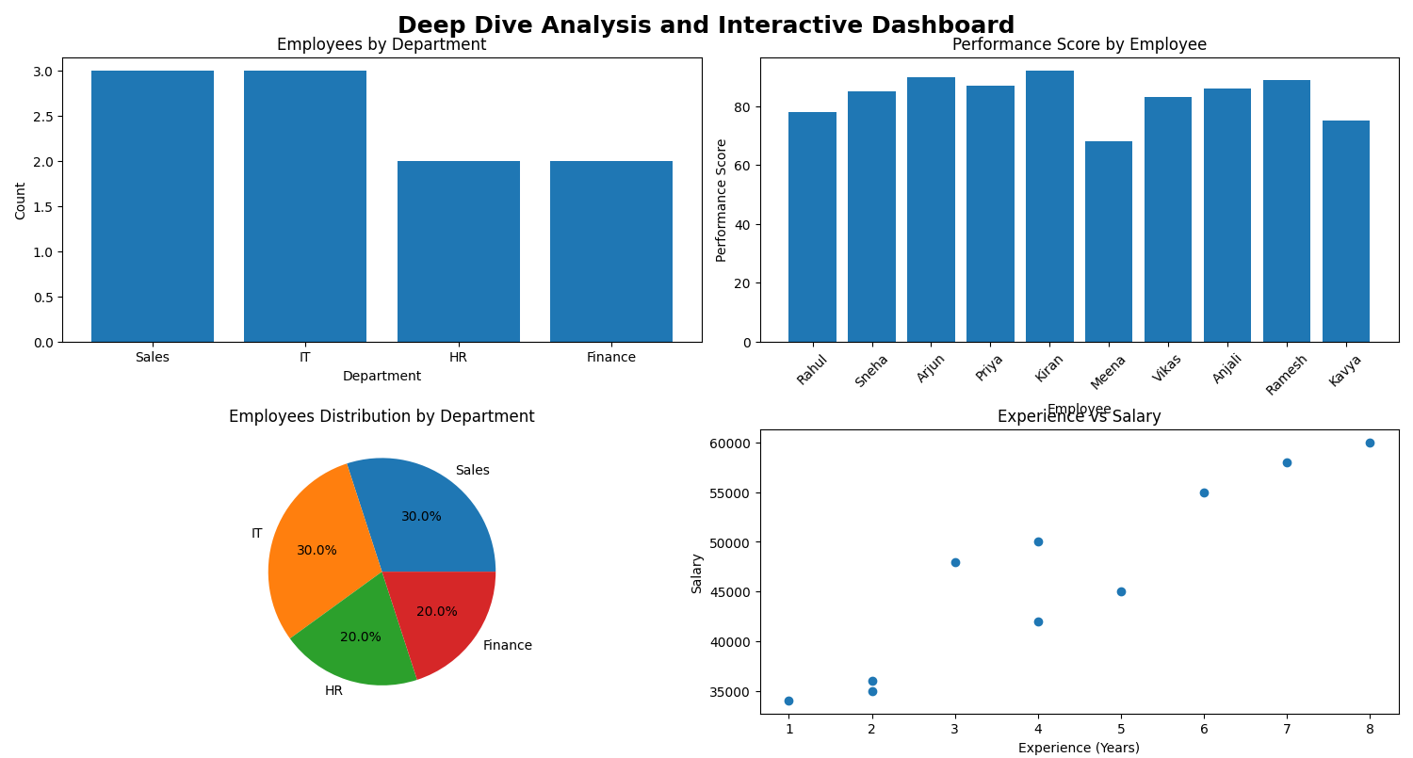
Task 3 – Interactive Dashboard
Dashboard Components
Employees by Department
Performance Score Analysis
Employee Distribution
Experience vs Salary
Key Findings
Sales and IT departments contain 60% of employees.
Most employees scored above 80.
Strong positive relationship between experience and salary.

Slide 6
Task 4 – Data Storytelling &Statistical Validation
Business Story
Employee analysis revealed:
Balanced workforce distribution
High overall employee performance
Experience-driven salary growth
Business Impact
Supports better HR decisions and workforce planning.
Hypothesis
H₀: Experience has no significant impact on salary.
H₁: Experience significantly impacts salary.
Method
Correlation Analysis
T-Test
Result
The analysis showed a positive relationship between employee experience and salary growth.

Slide 7
Major Insights
Insight 1
IT department records the highest average salary.
Insight 2
Top-performing employees score above 90.
Insight 3
Workforce distribution is balanced across departments.
Insight 4
Experience positively influences salary.
Insight 5
Data-driven HR strategies can improve productivity.
Skills Acquired
Technical Skills
Python
Pandas
NumPy
SQL
Matplotlib
Data Visualization
Analytics Skills
Data Cleaning
EDA
Dashboard Development
Statistical Analysis
Data Storytelling

Slide 8
Key Learnings from the Data Analytics Internship
Technical Skills
Learned data cleaning and preprocessing using Python and Pandas.
Performed Exploratory Data Analysis (EDA) to uncover patterns and trends.
Created meaningful visualizations using Matplotlib.
Developed interactive dashboards for business reporting.
Applied statistical techniques to validate analytical findings.
Analytical Skills
Converted raw data into actionable business insights.
Identified key performance indicators (KPIs) for decision-making.
Analyzed employee performance, salary trends, and departmental metrics.
Used data storytelling techniques to communicate insights effectively.
Professional Skills
Improved problem-solving and critical-thinking abilities.
Enhanced presentation and communication skills.
Learned project documentation and portfolio management using GitHub.
Gained experience in presenting analytical findings to stakeholders.

Slide 9
Conclusion
This Data Analytics Internship provided valuable hands-on experience in working with data throughout its entire lifecycle. From data cleaning and preparation to exploratory analysis, dashboard development, and statistical validation, each task contributed to building practical analytical skills.
Through this internship, I successfully:
Cleaned and transformed raw data into analysis-ready datasets.
Identified meaningful patterns and trends through EDA.
Built interactive dashboards to visualize key performance metrics.
Applied data storytelling techniques to communicate business insights.
Used statistical methods to validate findings and support decision-making.

Slide 10
Final Takeaway
This internship strengthened my technical, analytical, and problem-solving skills while giving me practical exposure to real-world data analytics projects. The knowledge and experience gained will help me confidently tackle future data-driven challenges and contribute effectively in the field of Data Analytics.
Thank You

